Slide 1











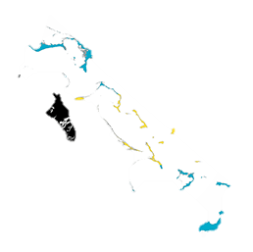



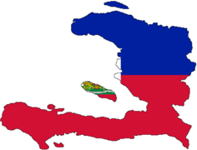

Slide 2

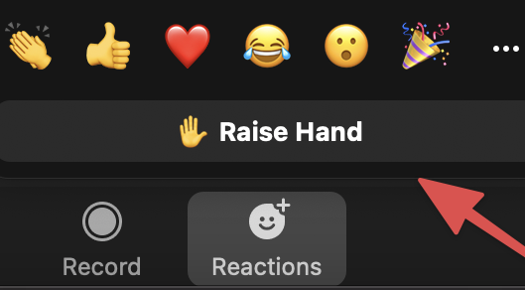



Getting Set Up…
1.
Rename your zoom
Name & Country
4.
Use Raise Hands
When Ready to Speak
2.
Mute Mic
If Not Speaking
5.
Recording
Session will be recorded
3.
Camera on
If Possible

Slide 3
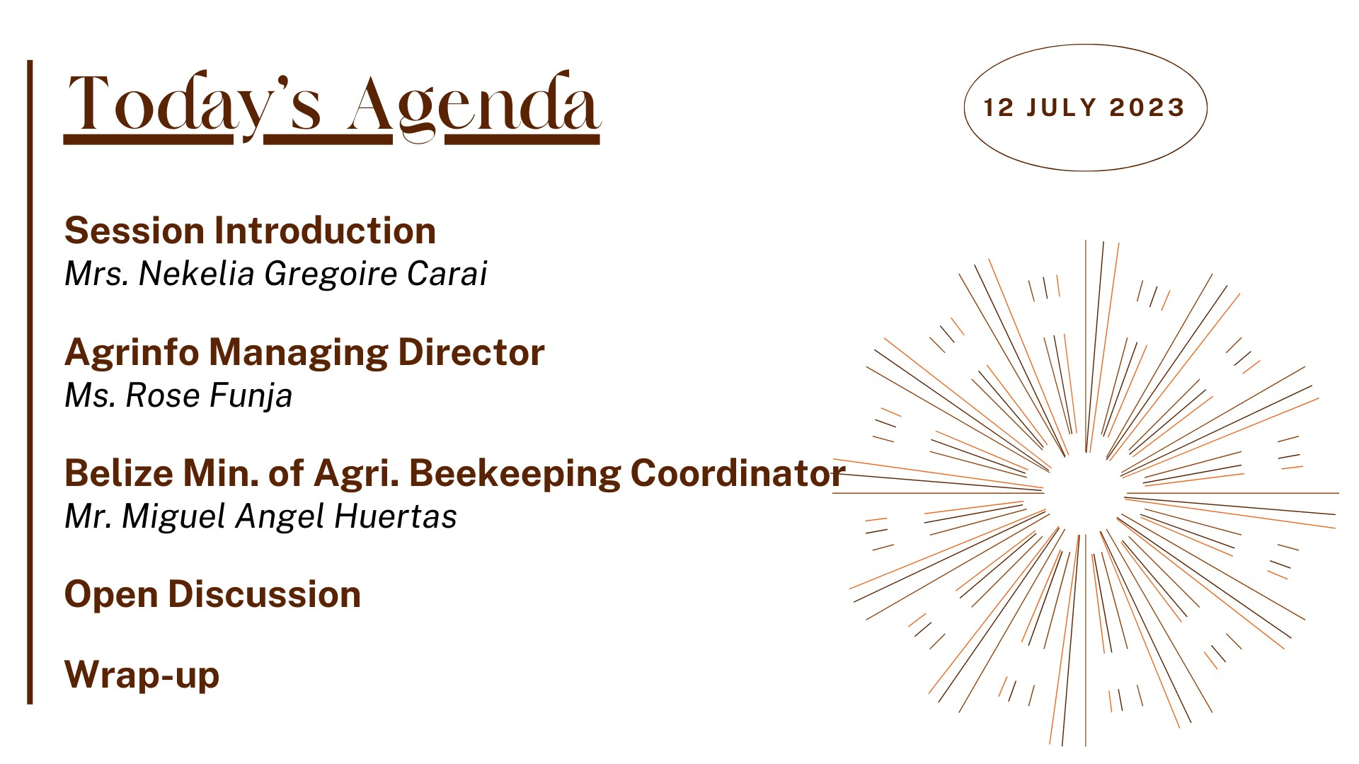

Slide 4














A Knowledge-to-Action Framework
Objectives
Raise awareness and share knowledge of climate smart agricultural practices and options for the Caribbean region
Build a community of interested and engaged actors at the regional and national levels
Promote enhanced coordination and collaboration among stakeholders across the region
Translate technical knowledge to practical action on the ground
The platform…

Slide 5


Slide 6


Slide 7
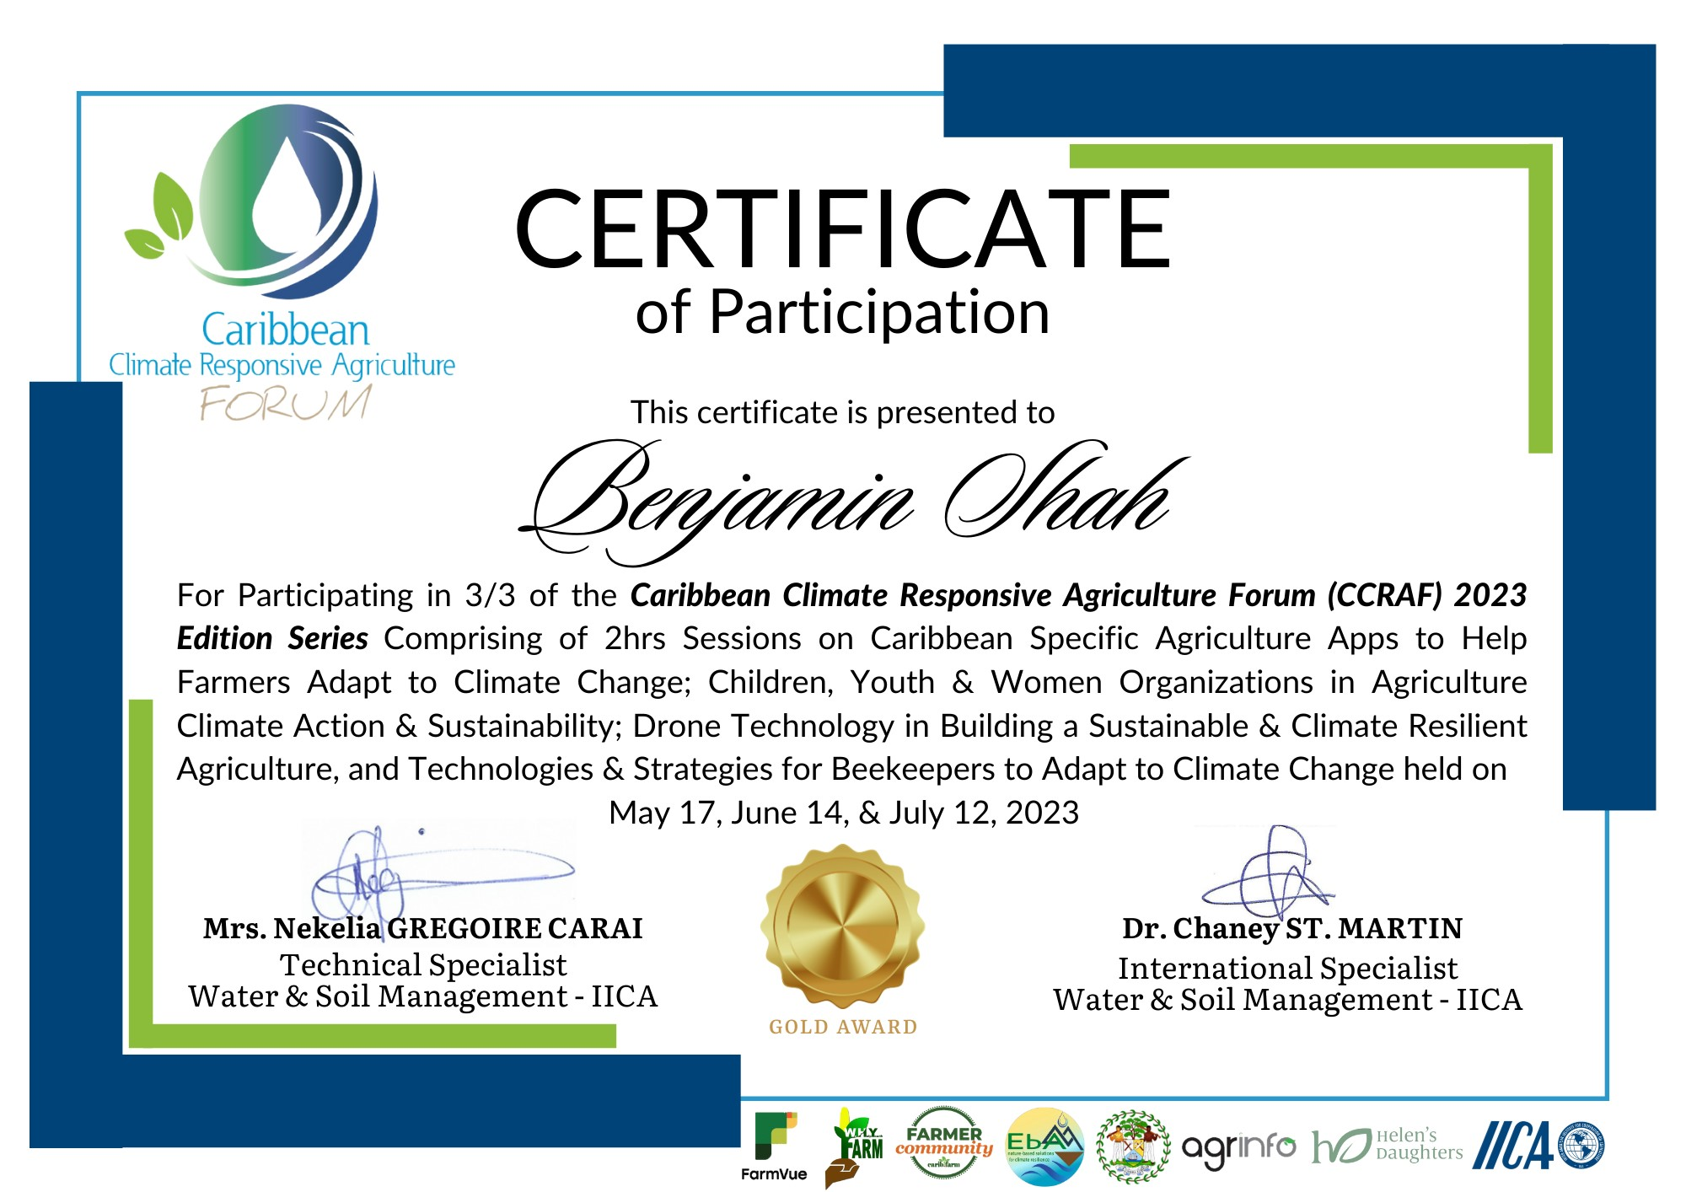
Notes:
https://farmvue.app/

Slide 8
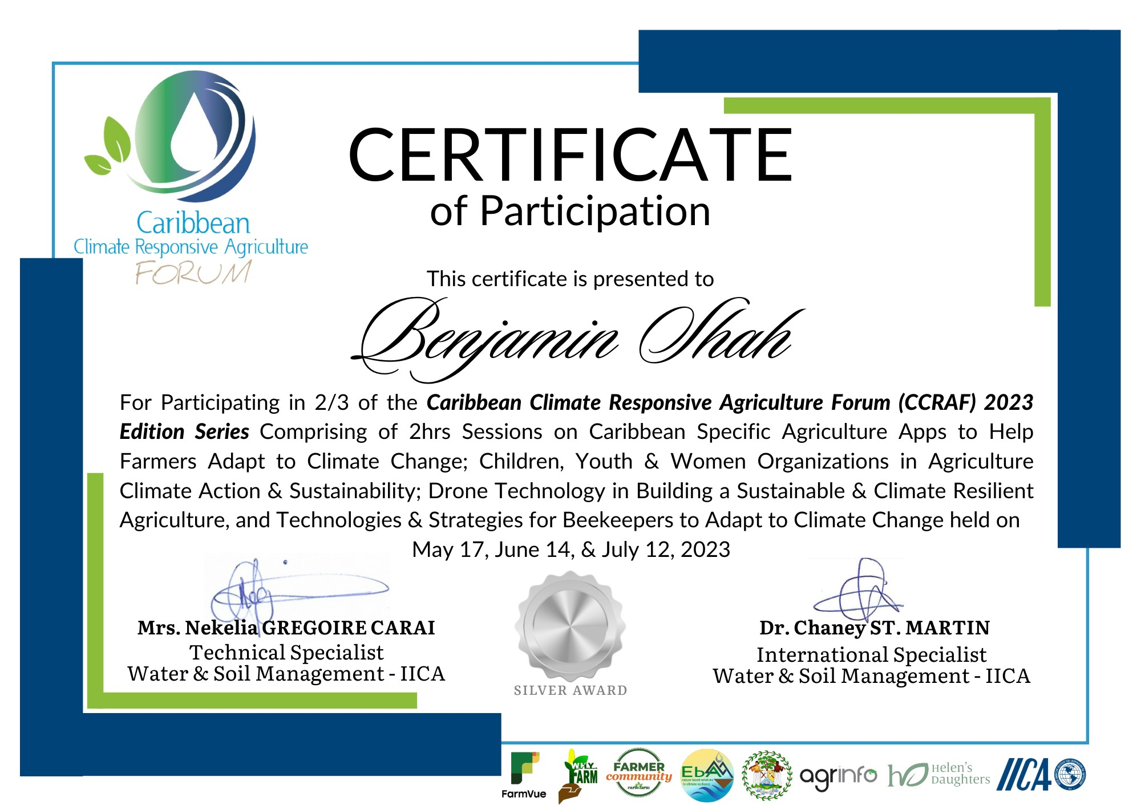
Notes:
https://farmvue.app/

Slide 9
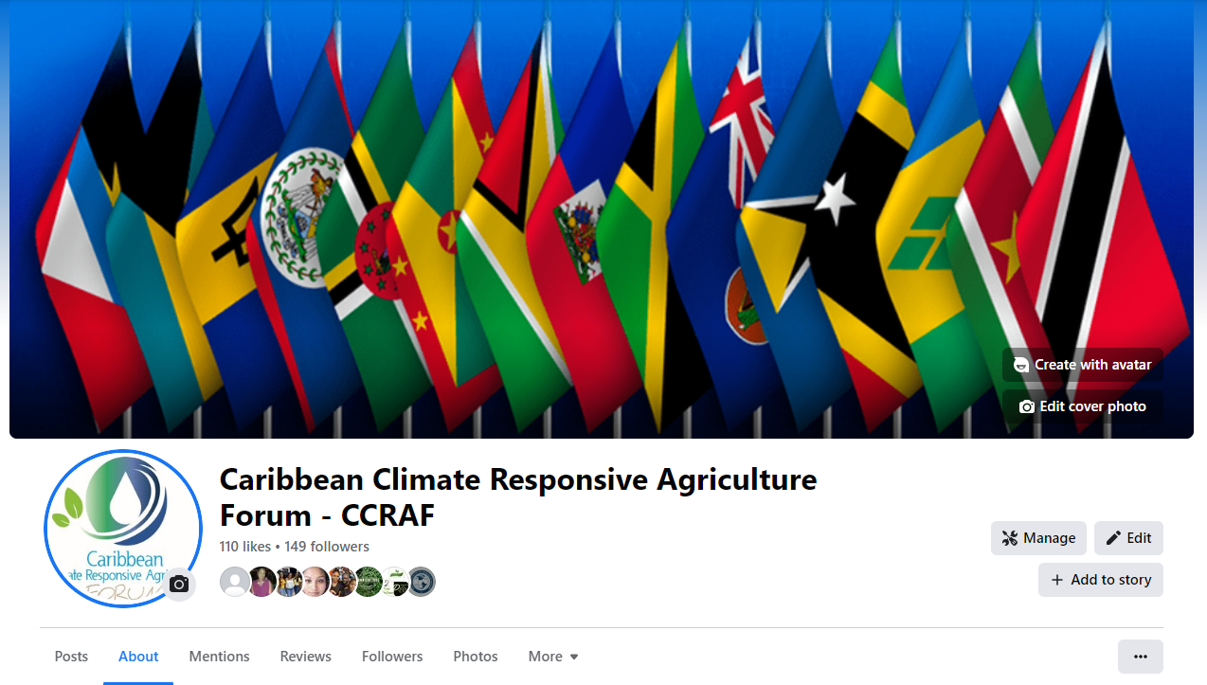
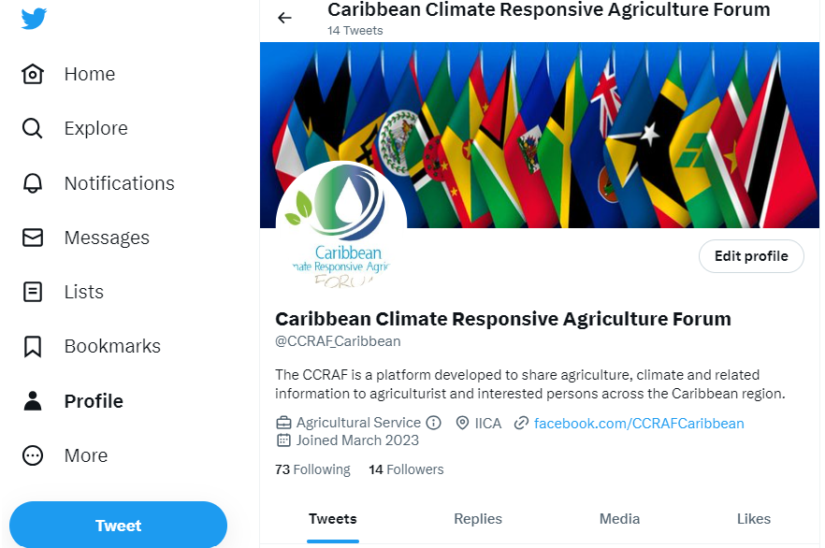
CCRAF Social Media Platforms
Facebook
Twitter
Notes:
https://www.facebook.com/CCRAFCaribbean
https://twitter.com/CCRAF_Caribbean

