Slide 1











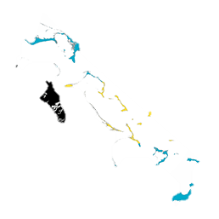



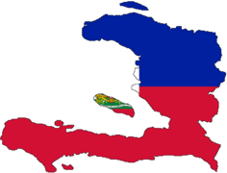

Slide 2



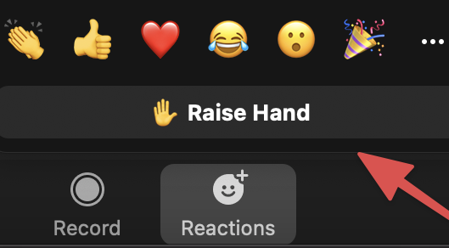



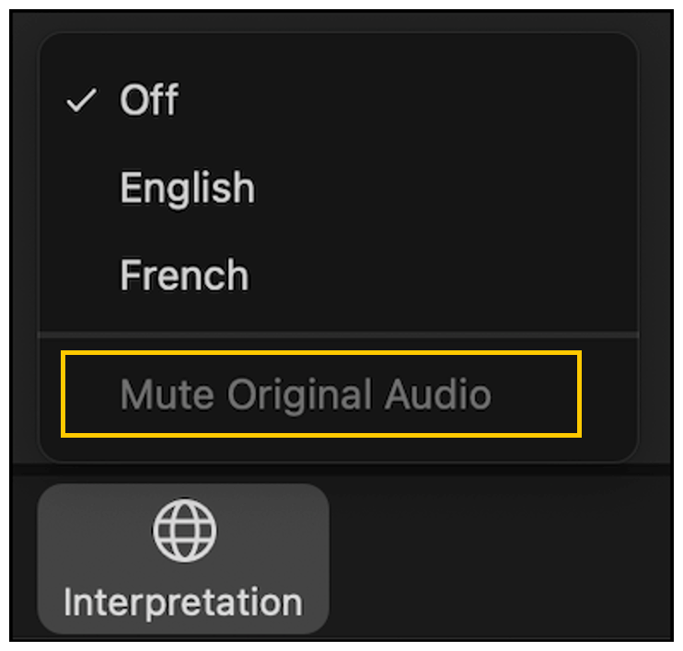
Getting Set Up…
1.
4.
Rename Your Zoom
Name & Country
Use Raise Hand
When Ready to Speak
2.
5.
Mute Mic
If Not Speaking
Recording
Session Will Be Recorded
3.
6.
Interpretation Available
Select Your Language
Camera On
If Possible

Slide 3













A Knowledge-to-Action Network
OBJECTIVES
Raise awareness and share knowledge of climate smart agricultural practices and options for the Caribbean region
Build a community of interested and engaged actors at the regional and national levels
Promote enhanced coordination and collaboration among stakeholders across the region
Translate technical knowledge to practical action on the ground

Slide 4
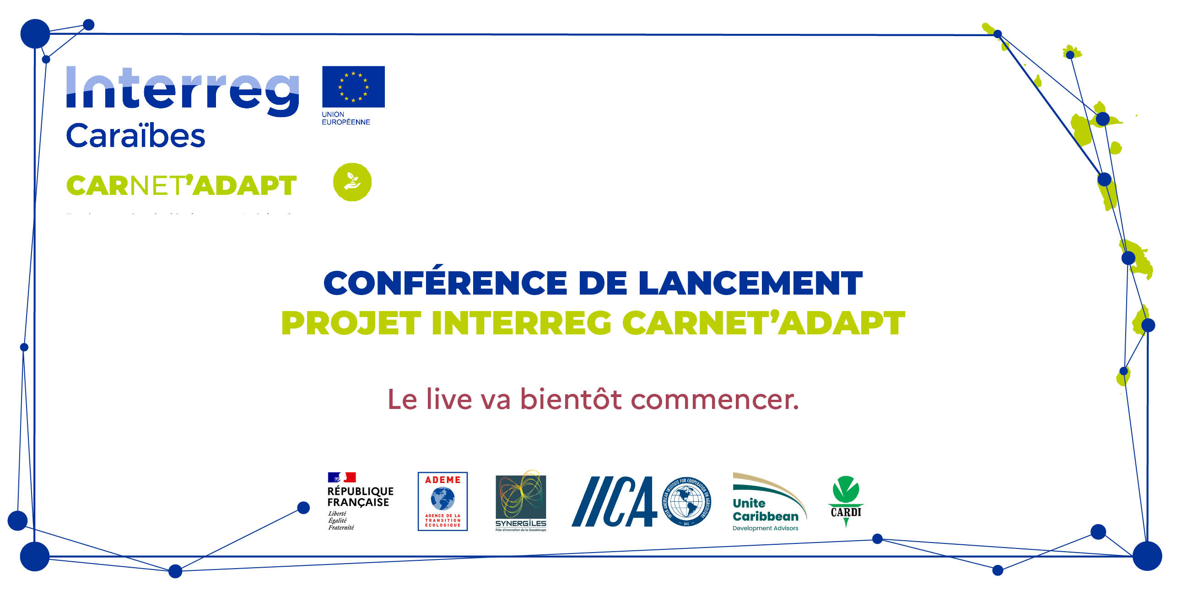
Risk Management Solutions
for Supply Shortages

Slide 5
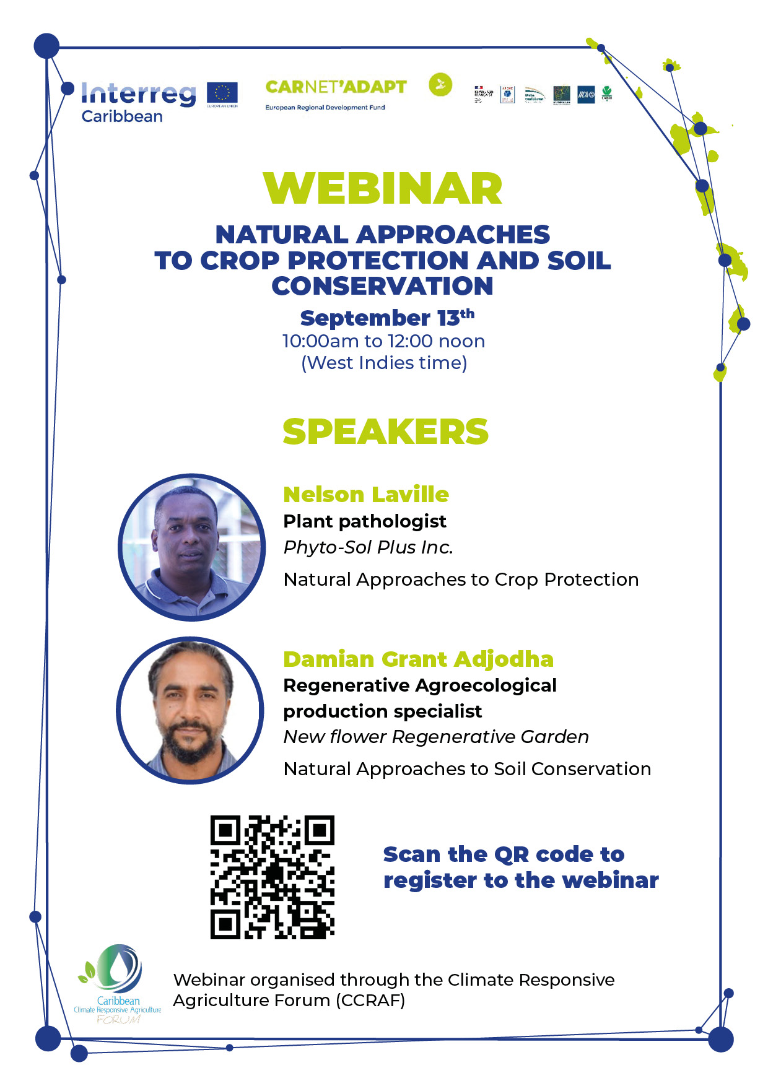
Agriculture and Agro-Food Project Manager Northern Grande-Terre Urban Community
Agenda
Ordre du Jour
Welcome: Nekelia Gregoire Carai
Technical Specialist Soil & Water - IICA
Remarks: Marianna Martel
Coordinator of the Sustainable Territories
ADEME Guadeloupe
Speaker 1: Dominique Zami
CEO – PTL AGRO
Guadeloupe
Speaker 2: Yannick Boc
Manager - Agriculture and Agro-Food Project
Northern Grande-Terre Urban Community
Speaker 3: Céline Carles
Manager – Environment & Agriculture
DENEL Martinique
Questions & Answers
Closing
Welcome: Nekelia Gregoire Carai
Spécialiste Technique Sol & Eau- IICA
Remarques: Marianna Martel
Coordinatrice Territoire Durable
ADEME Guadeloupe
Intervenant 1: Dominique Zami
Dirigent – PTL AGRO
Guadeloupe
Intervenant 2: Yannick Boc
Chargée de Mission Agriculture et Agro-Alimentaire
Communauté D’Agglomération du Nord Grande-Terre
Intervenant 3: Céline CARLES
Chargée de Mission Environnment et Agriculture
DENEL Martinique
Questions & Réponses
Conclusion

