Slide 1
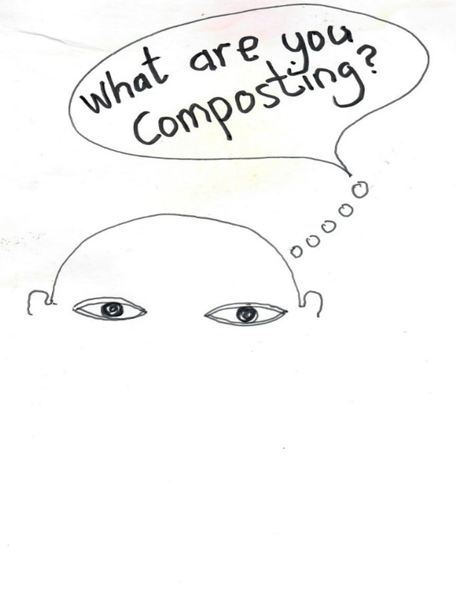
Mario Lewis
International Network of Innovative Partners for Sustainable Intelligent Systems
Inipsis

Slide 2
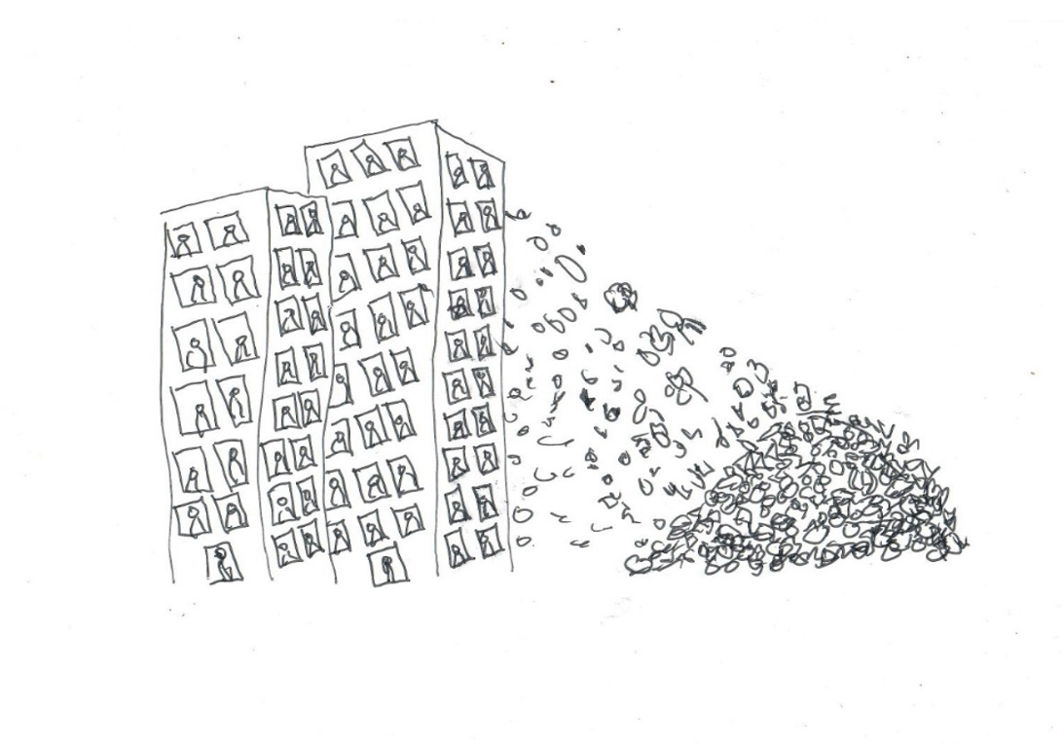
Food waste recycling methods and technologies for households
Notes:
1.5-2.5lbs per day, waste diversion, 100% recovery,

Slide 3
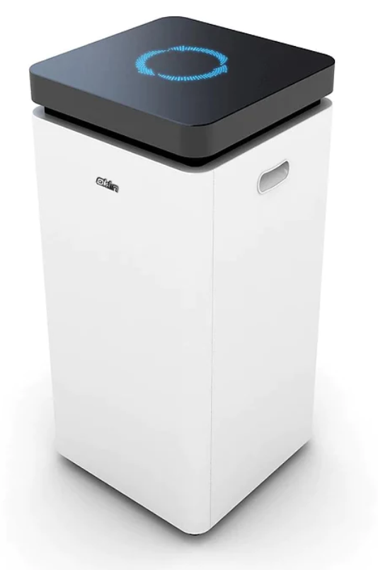
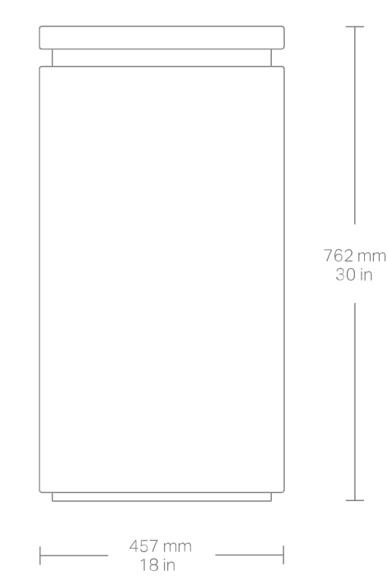
Notes:
24-48 hrs, 10lbs per day, batch system, continuous,

Slide 4
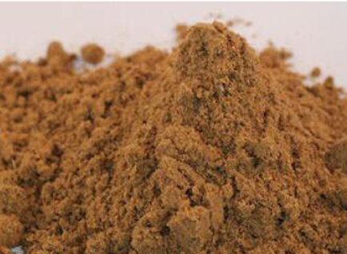


Slide 5
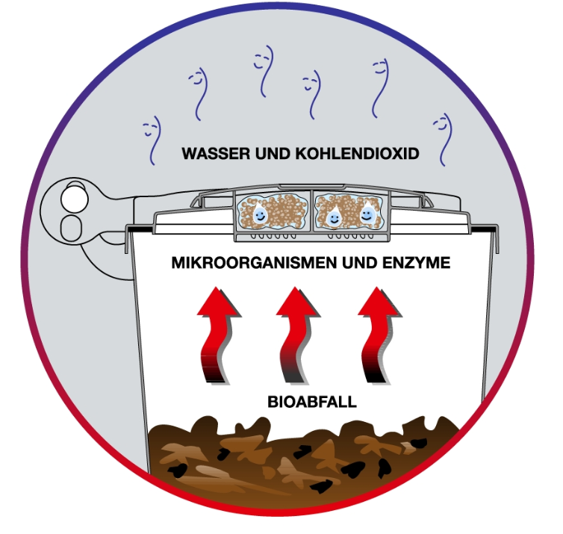
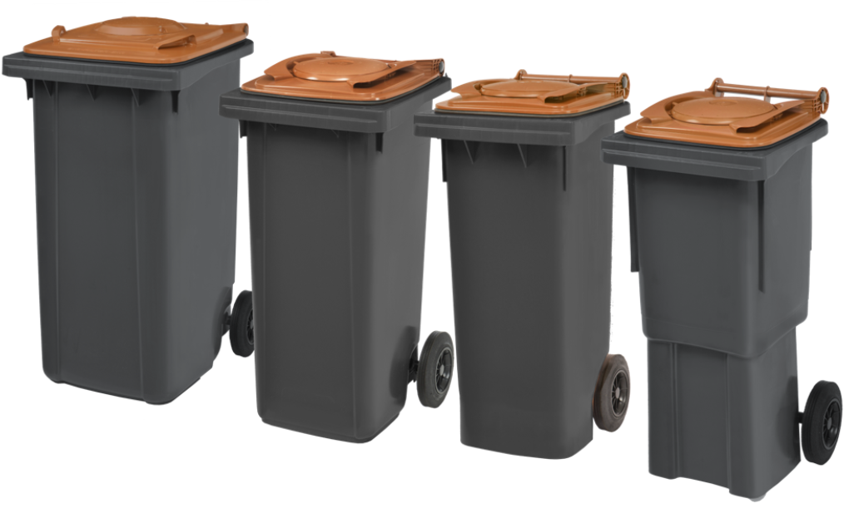

Slide 6
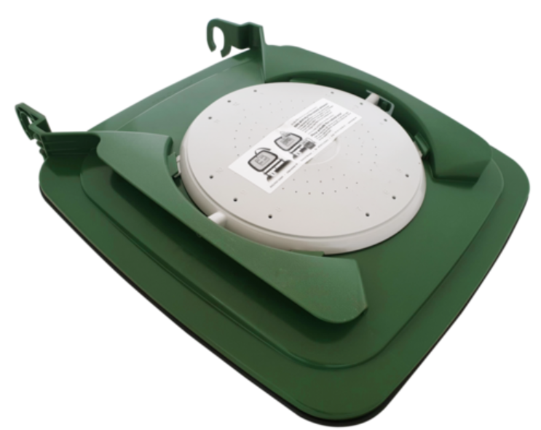
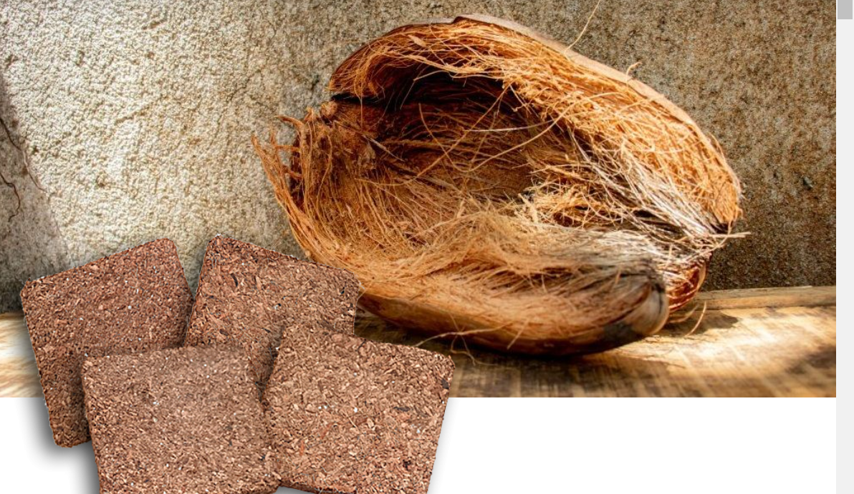

Slide 7
Case study: Hilton Trinidad & Conference Centre
15, 411 lbs
100%
Total food waste collected
Total diverted from the landfill
(July 18-Sept 16, 2019)
170, 861
10,017 lbs
Total pounds of CO₂ saved per year
Total Compost

Slide 8
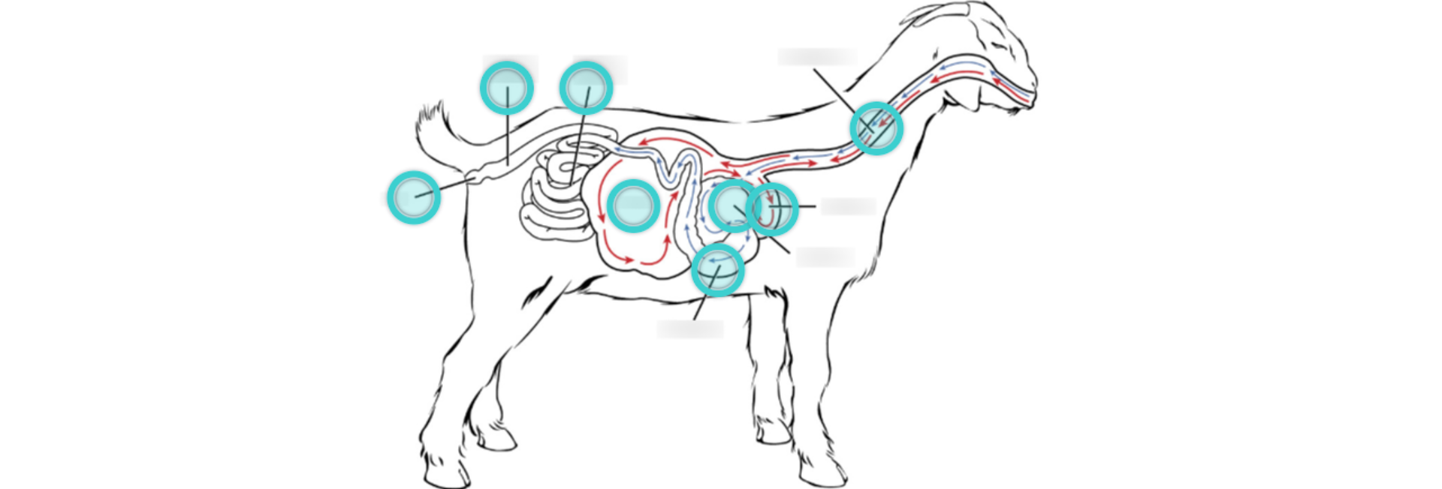
Lessons or guide to composting livestock manure and crop waste
Notes:
Ruminants, non-ruminants, grasses, trees, vegetables, fruits

Slide 9
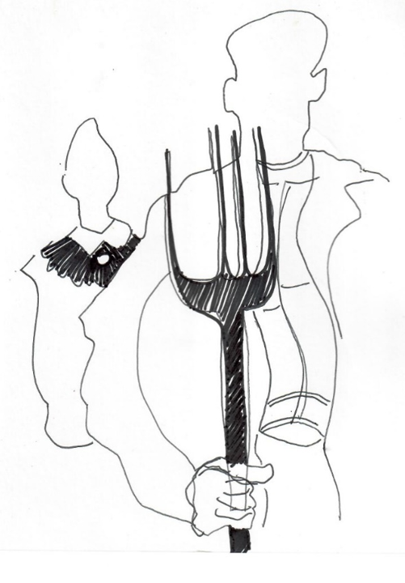
The farmer and his wife
Notes:
Circular agriculture logistics and design, schedule, tools, technique, monitor, record, limited labour,

Slide 10
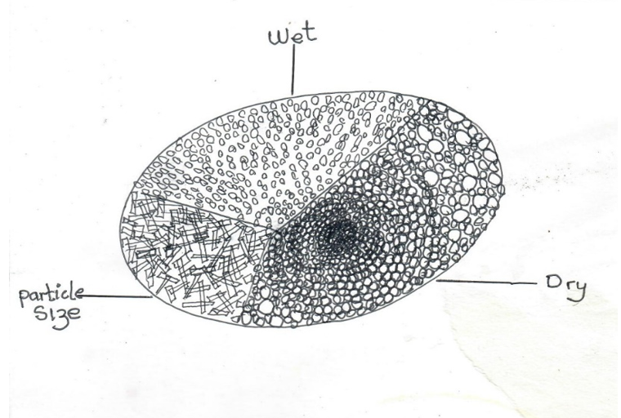
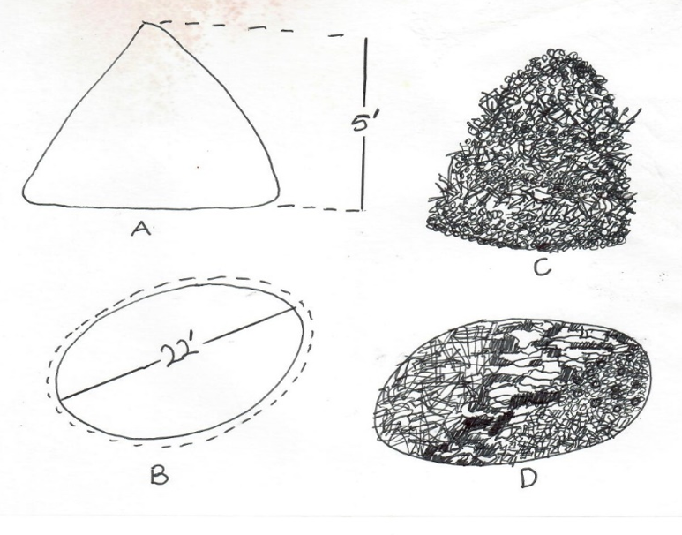
On-farm audit: material mapping, consistency, quantity, quality
Static pile

Slide 11
Hourly rate = $000.00
Daily rate = $000.00
3-cubic feet = 1 barrow
20-barrows = 60-cubic feet
60 cubic feet = 1-pile
1 pile = $000.00
1 cubic foot = $000.00
Loss factor = 20-50%

Slide 12
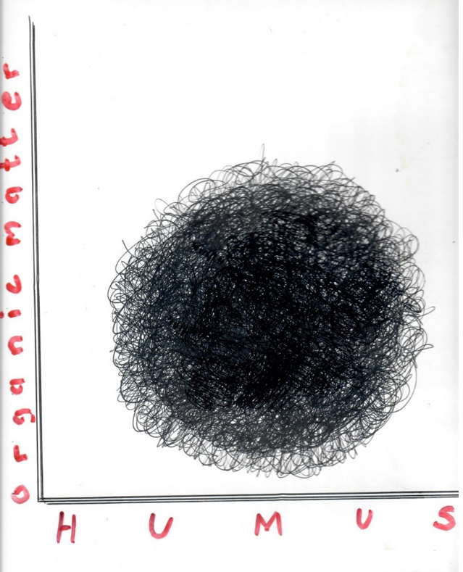
End-product feasibility: waste type, quality control, testing
Notes:
Loss factor 20-50%, bulking biomass, sifting, soil pan, drainage, organisms, ingredient,

Slide 13
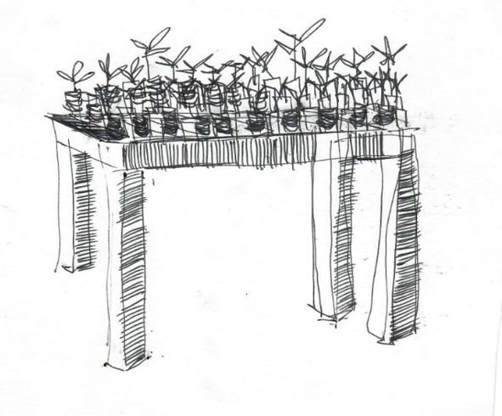
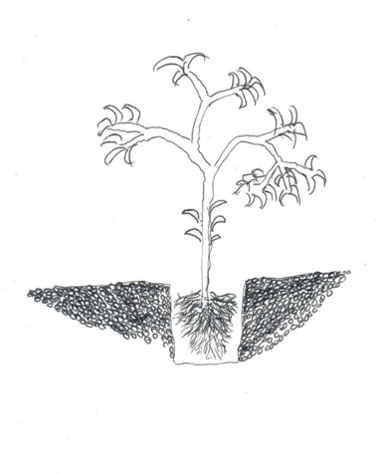
Seedling germination
Root mass

Slide 14
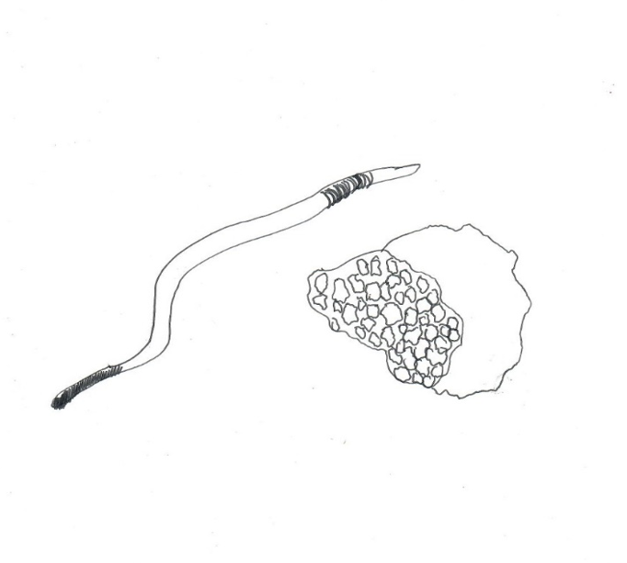
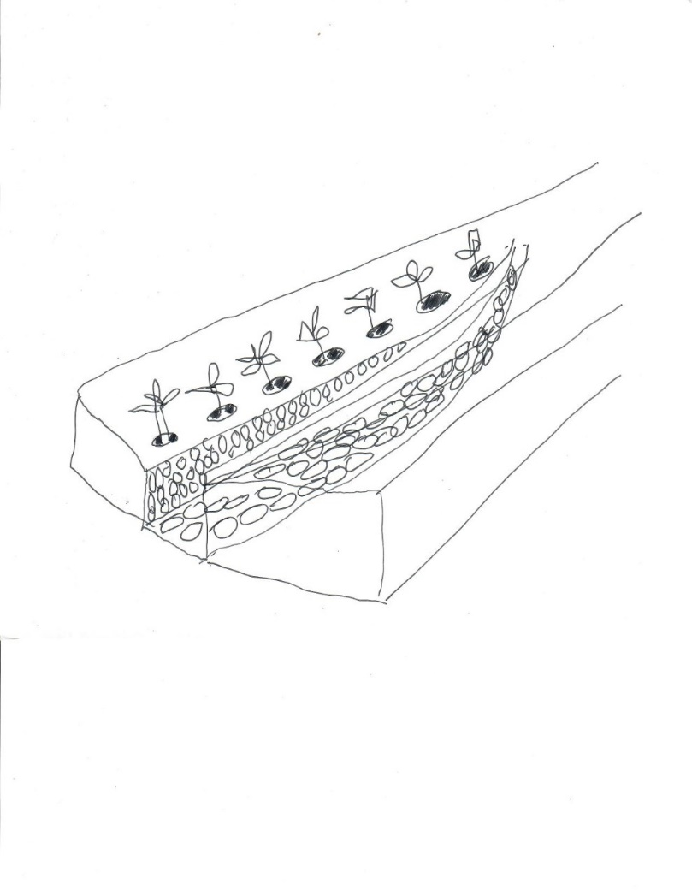
Earthworm population
Water holding capacity

Slide 15

Challenges and necessary measures

Slide 16

Water Heat Air Time
Notes:
Weather, stockpile, drainage, cover, airate, moisture, storage,

Slide 17

Notes:
Principles temperature monitor

Slide 18

Mario lewis crf.ideas@gmail.com

